Slide 1
CS 478 - Machine Learning
Instance Based Learning
(Adapted from various sources)
Notes:
Fall 2004
CS478 - Machine Learning

Slide 2
Introduction
Instance-based learning is often termed lazy learning, as there is typically no “transformation” of training instances into more general “statements”
Instead, the presented training data is simply stored and, when a new query instance is encountered, a set of similar, related instances is retrieved from memory and used to classify the new query instance
Hence, instance-based learners never form an explicit general hypothesis regarding the target function. They simply compute the classification of each new query instance as needed

Slide 3
k-NN Approach
The simplest, most used instance-based learning algorithm is the k-NN algorithm
k-NN assumes that all instances are points in some n-dimensional space and defines neighbors in terms of distance (usually Euclidean in R-space)
k is the number of neighbors considered

Slide 4
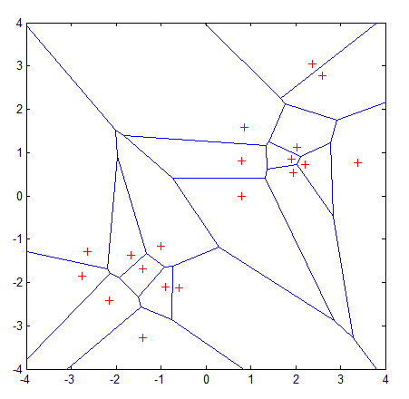
Graphic Depiction
Properties:
All possible points within a sample's Voronoi cell are the nearest neighboring points for that sample
For any sample, the nearest sample is determined by the closest Voronoi cell edge

Slide 5
Basic Idea
Using the second property, the k-NN classification rule is to assign to a test sample the majority category label of its k nearest training samples
In practice, k is usually chosen to be odd, so as to avoid ties
The k = 1 rule is generally called the nearest-neighbor classification rule

Slide 6
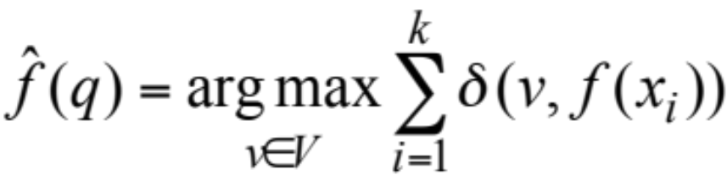
k-NN Algorithm
For each training instance t=(x, f(x))
  Add t to the set Tr_instances
Given a query instance q to be classified
  Let x₁, …, x_{k} be the k training instances in Tr_instances nearest to q
  Return
Where V is the finite set of target class values, and δ(a,b)=1 if a=b, and 0 otherwise (Kronecker function)
Intuitively, the k-NN algorithm assigns to each new query instance the majority class among its k nearest neighbors

Slide 7
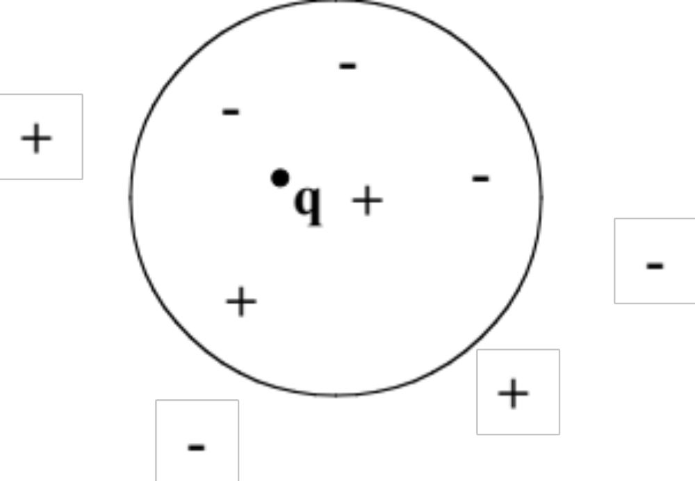
Simple Illustration
q is + under 1-NN, but – under 5-NN

Slide 8

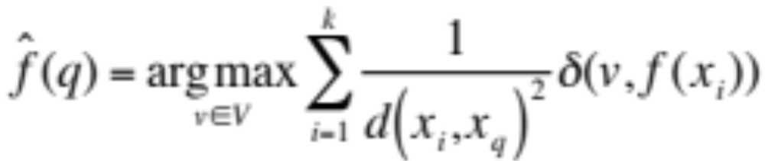
Distance-weighted k-NN
Replace by:

Slide 9
Scale Effects
Different features may have different measurement scales
  E.g., patient weight in kg (range [50,200]) vs. blood protein values in ng/dL (range [-3,3])
Consequences
  Patient weight will have a much greater influence on the distance between samples
  May bias the performance of the classifier

Slide 10
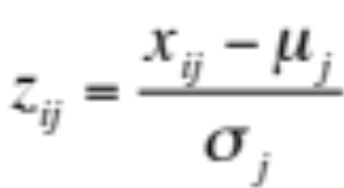



Standardization
Transform raw feature values into z-scores
  is the value for the i^{th} sample and j^{th} feature
  is the average of all for feature j
  is the standard deviation of all over all input samples
Range and scale of z-scores should be similar (providing distributions of raw feature values are alike)

Slide 11
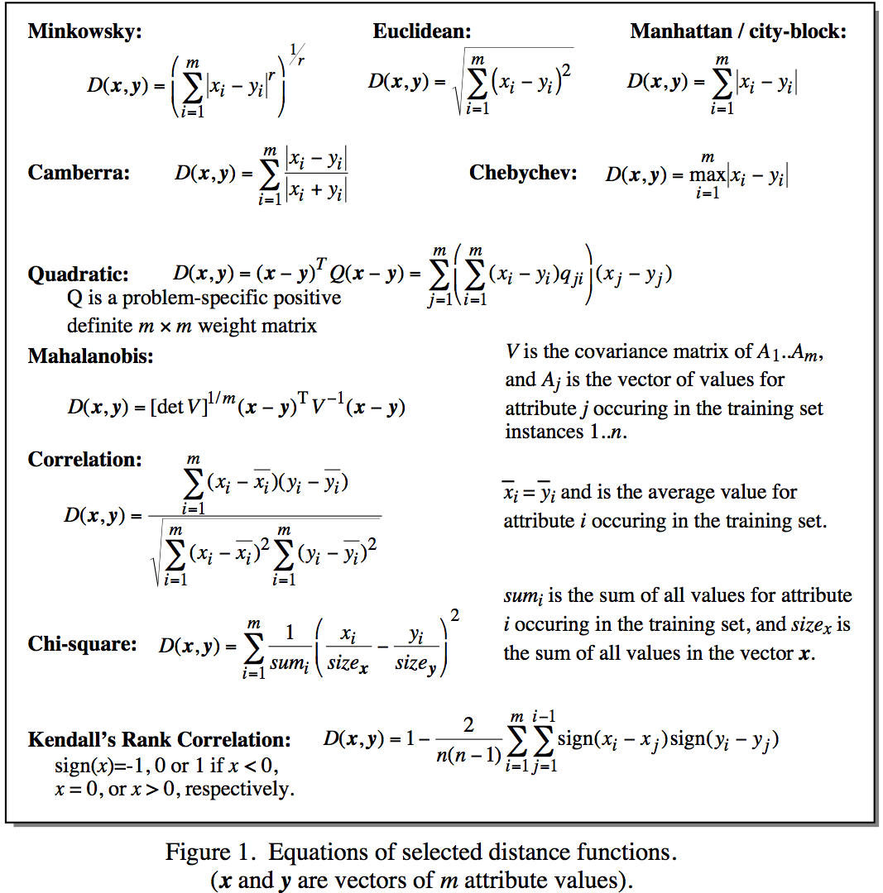
Distance Metrics
Notes:
Minkowsky = l-norm

Slide 12
Issues with Distance Metrics
Most distance measures were designed for linear/real-valued attributes
Two important questions in the context of machine learning:
  How best to handle nominal attributes
  What to do when attribute types are mixed

Slide 13
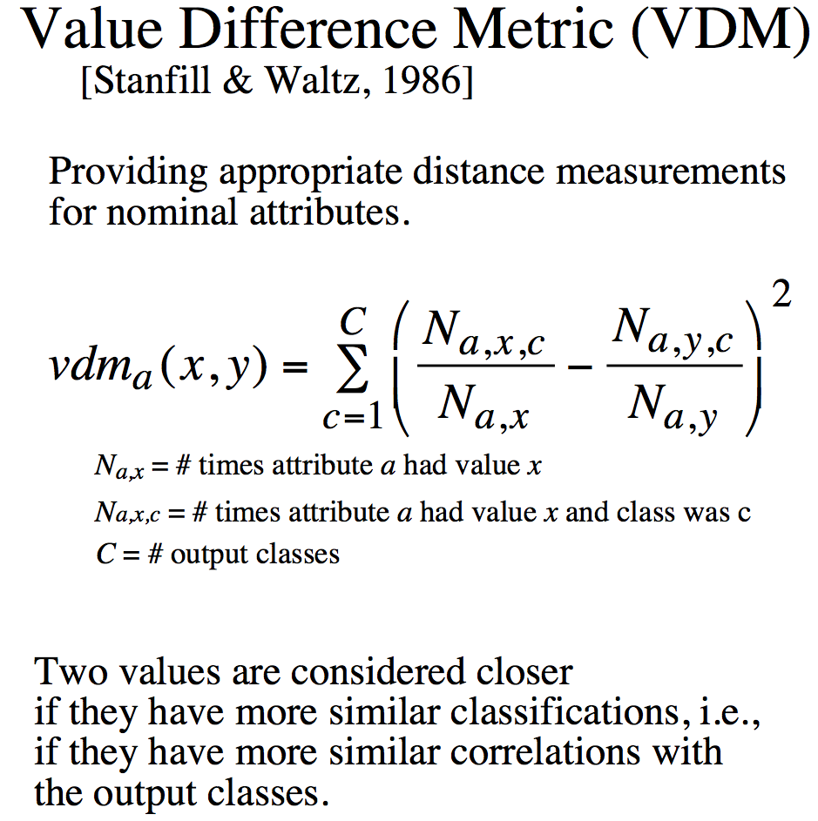
Distance for Nominal Attributes
Notes:
Do a single example here. Shape (Round, Square) 6/10 and 3/5

Slide 14
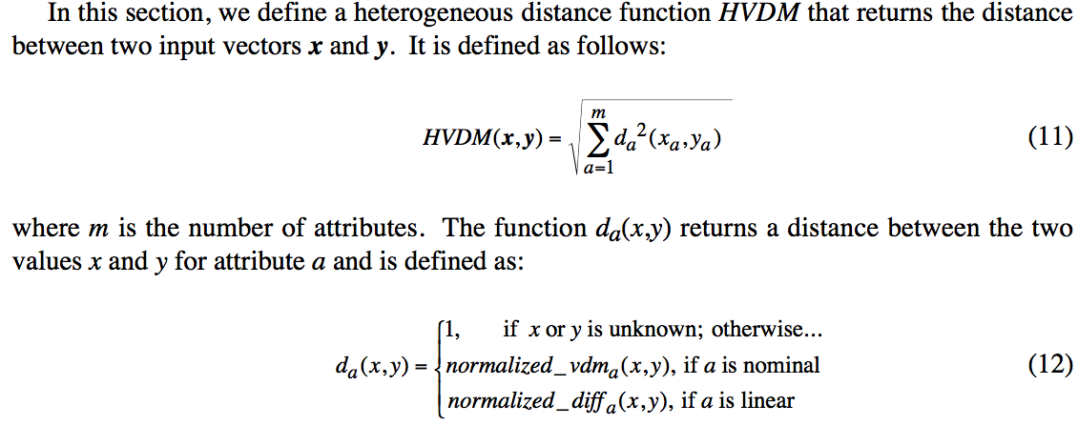
Distance for Heterogeneous Data
Wilson, D. R. and Martinez, T. R., Improved Heterogeneous Distance Functions, Journal of Artificial Intelligence Research, vol. 6, no. 1, pp. 1-34, 1997

Slide 15
Some Remarks
k-NN works well on many practical problems and is fairly noise tolerant (depending on the value of k)
k-NN is subject to the curse of dimensionality (i.e., presence of many irrelevant attributes)
k-NN needs adequate distance measure
k-NN relies on efficient indexing

Slide 16
How is kNN Incremental?
All training instances are stored
Model consists of the set of training instances
Adding a new training instance only affects the computation of neighbors, which is done at execution time (i.e., lazily)
    Note that the storing of training instances is a violation of the strict definition of incremental learning.

Slide 17
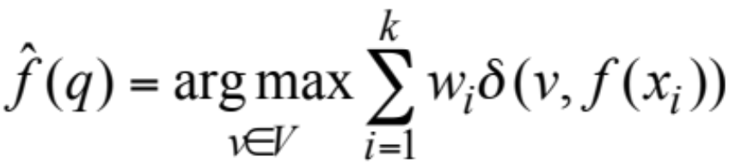
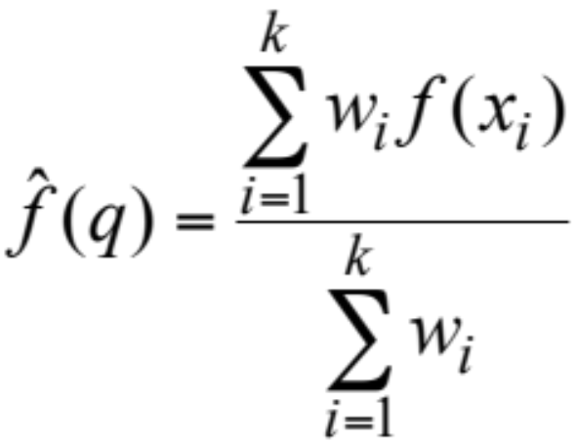
Predicting Continuous Values
Replace by:
Note: unweighted corresponds to w_{i}=1 for all i

Slide 18
Case-based Reasoning
An extension of IBL
  Cases represented by rich symbolic descriptions, rather than ℜ^{n}
  Multiple retrieved cases are combined using knowledge-based reasoning rather than statistical methods
  Strong interaction among case retrieval, knowledge-base reasoning and problem solving (e.g., adapting cases for matching)

